Slide 1

Reaction Intermediates
The intermediate species formed and utilized during the
stepwise progress of a reaction to reach its preferred
products are called reaction intermediates or reactive
intermediates
They may be cation ,anion or radical species
They are short lived
They can’t be isolated
They can’t be stored
They are highly unstable and reactive
They can be identified using sophisticated techniques
like Spectroscopy
Examples are: Carbocations, Carbanions and Free radicals

Slide 2
cabocations
A carbocation is a cationic reaction intermediate species that has a carbon that bears a positive charge and is two electrons short for completing its octet.
In carbocation the positively charged carbon atom has 6 electrons around it .Thus it is electron deficient,it has stong tendency to accept a pair of electrons to complete the octet.Hence it is highly reactive ,short lived species.Also being electron deficient with 2 electrons short at + ve carbon centre, they are electrophiles and lewis acids.They are easily attracted by nucleophiles

Slide 3
Examples for cabocation are:
⁺CH₃ - Methyl Cation
CH₃-⁺CH₂ -Ethyl Cation
(CH₃)₂⁺CH -Isopropyl Cation
(CH₃)₃ C⁺ -t-Butyl Cation
CH₂=CH-⁺CH₂ -Allyl Cation
C₆H₅-⁺CH₂ -Benzyl Cation

Slide 4
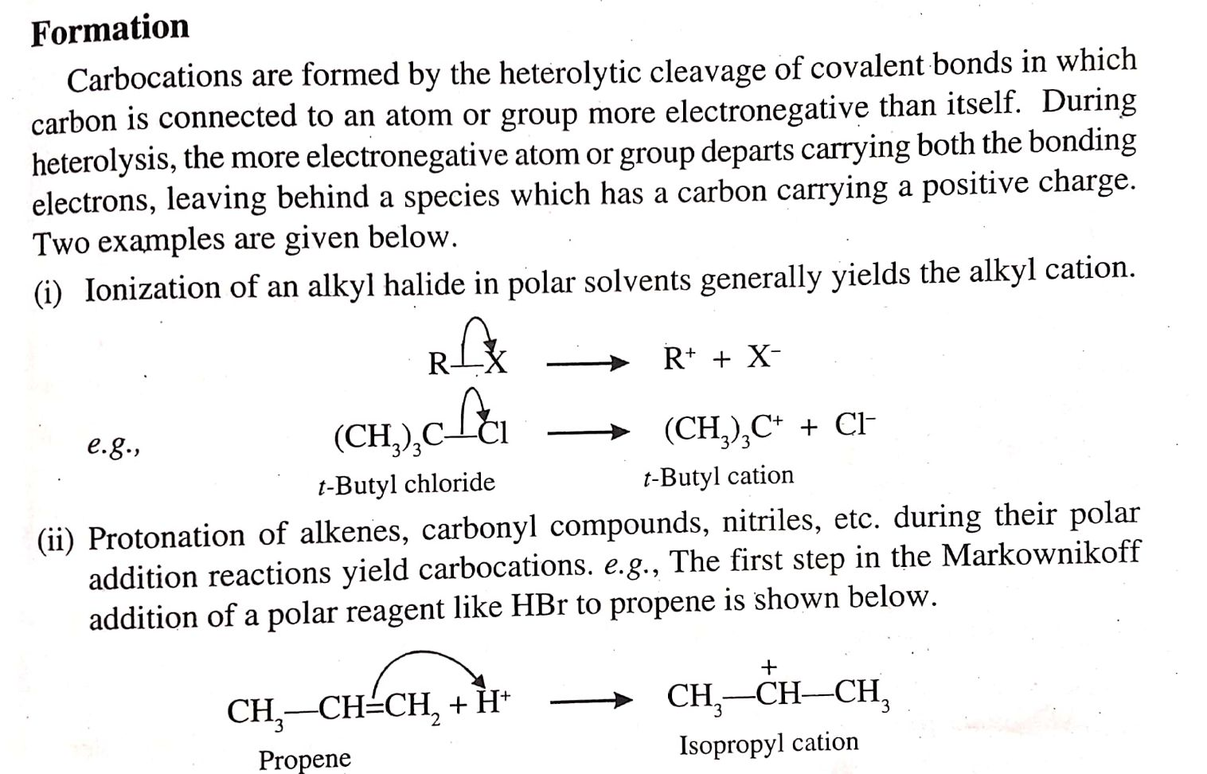
Formation of Carbocation

Slide 5
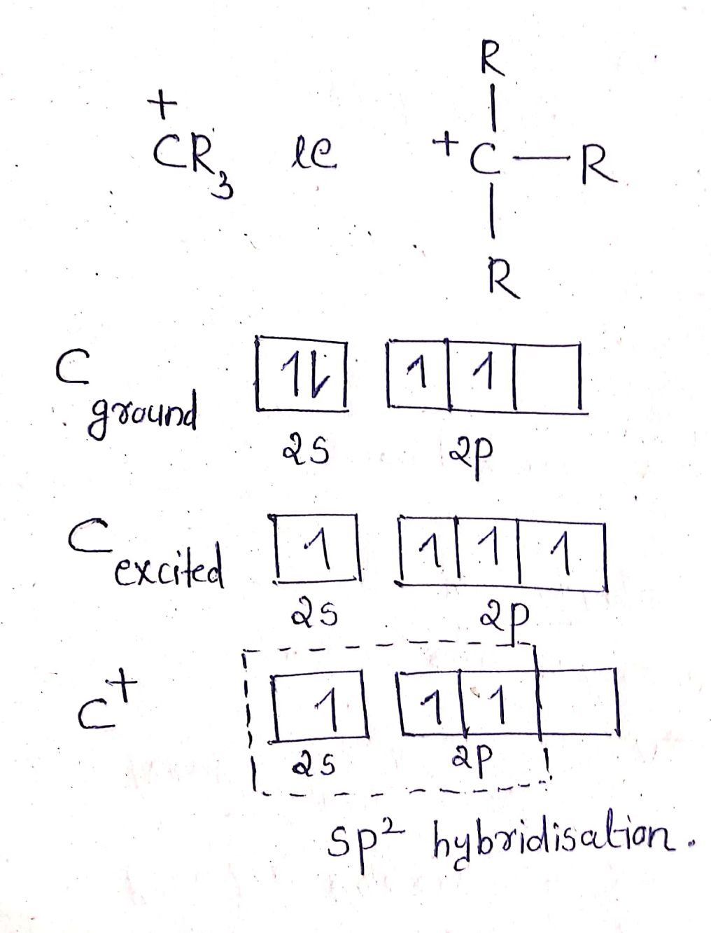
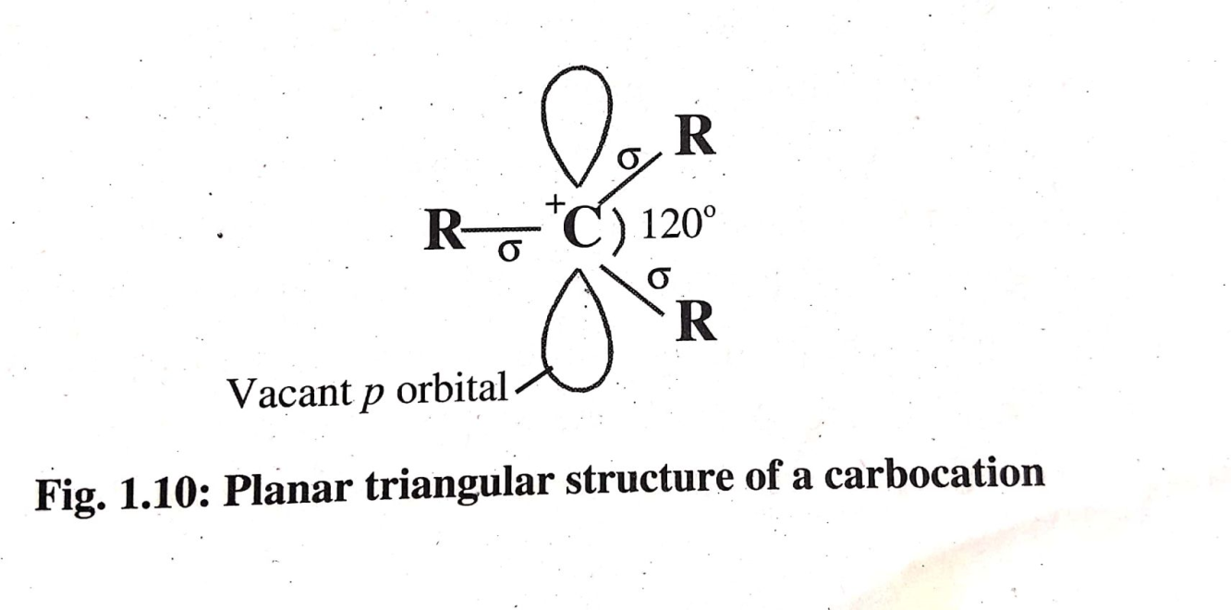
Hybridisation of Carbocation
The + vely charged carbon in carbocation is SP² hybridised.
The SP² hybrid orbitals are used to form sigma bonds with three atoms or groups creating a trigonal planar structure with a bond angle of 120^{0.} One vacant unhybridised p orbital stands perpendicular to the above plane.

Slide 6
Stability of carbocations
Any structural factor that tends to disperse the +ve charge on the carbon and distribute it over the rest of the molecule tends to stabilize the carbocation whereas any factor that tends to intensify the positive charge on the carbon tends to destabilize the carbocation
The presence of Electron –donating group attached to the positively charged carbon tends to decrease the +ve charge on the carbon and disperse it ,and thereby tends to stabilize the carbocation.
The presence of Electron –withdrawing group attached to the positively charged carbon tends to increase the +ve charge on the carbon and thereby tends to destabilize the carbocation.
The dispersal of the positive charge on the carbon is possible through resonance or delocalization also.

Slide 7
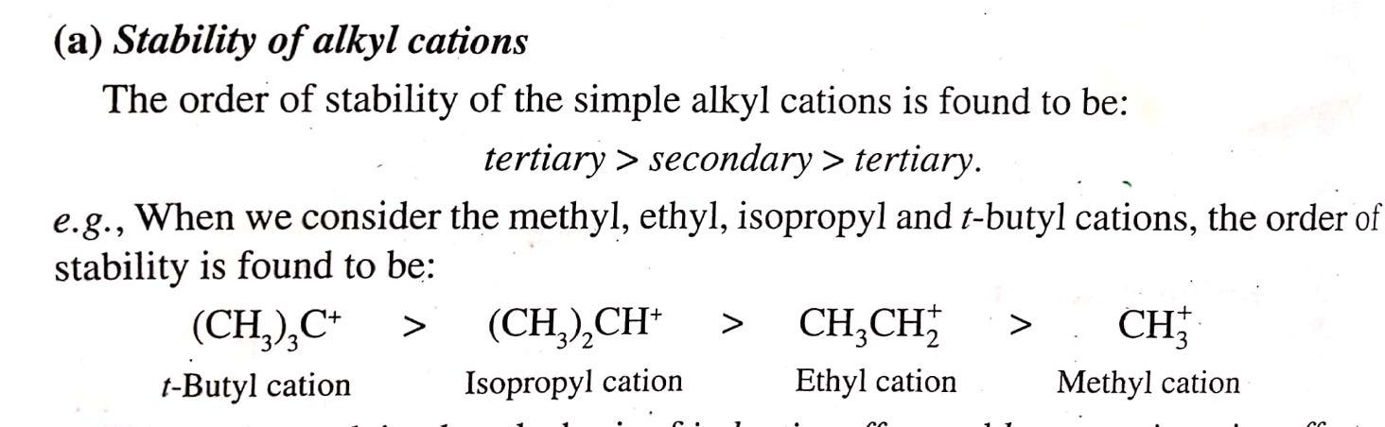
Stability of alkyl carbocations
Primary

Slide 8
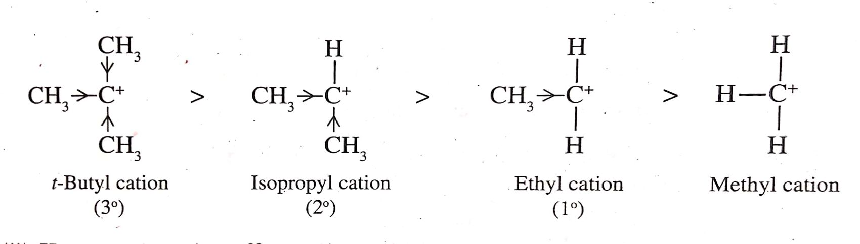
Based on Inductive Effect
CH3 group has electron donating inductive effect. As the no of +I groups connecting to the +vely charged carbon increases ,the dispersal of +ve charge also increases,which in turn increases the stability.

Slide 9
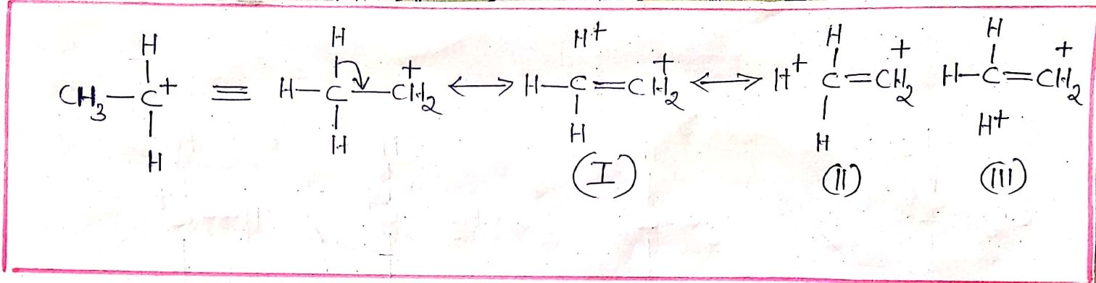
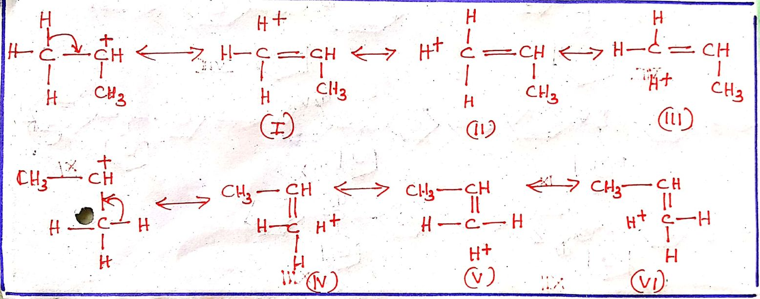
Based on Hyperconjugative Effect
Ethyl cation(Primary carbocation)
Isopropyl cation(Secondary carbocation)

Slide 10
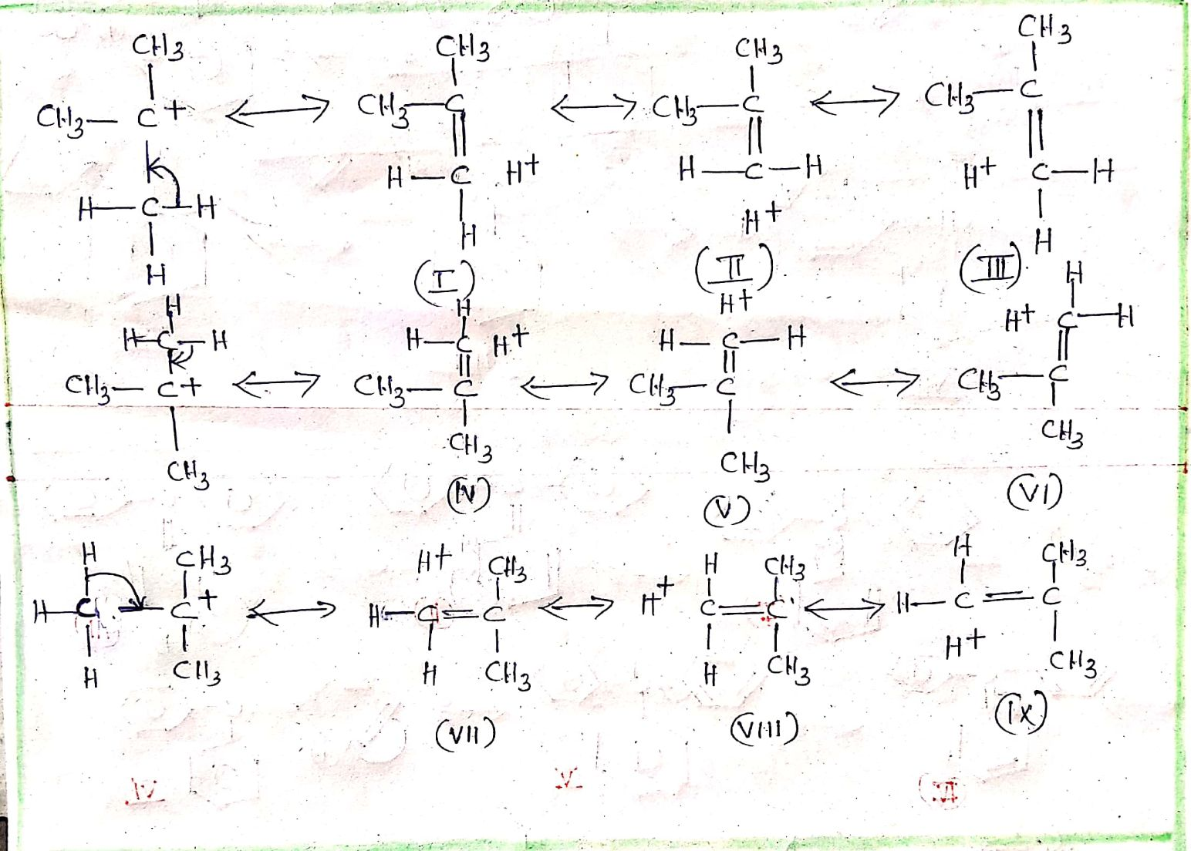
t-Butyl cation(Tertiary carbocation)

Slide 11
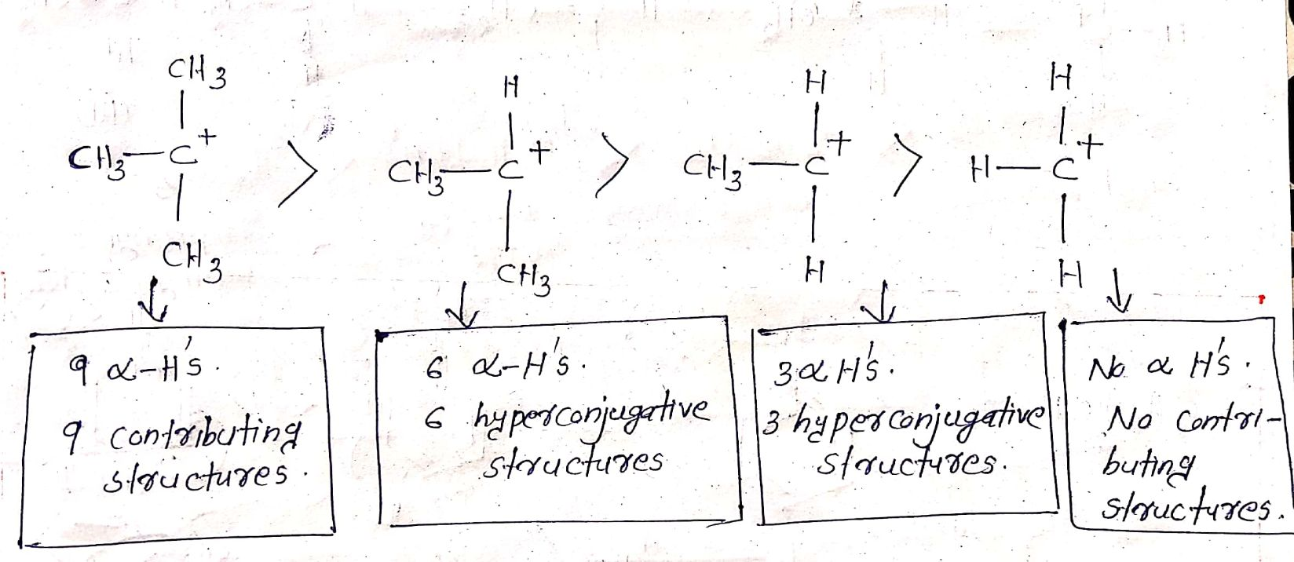

Slide 12
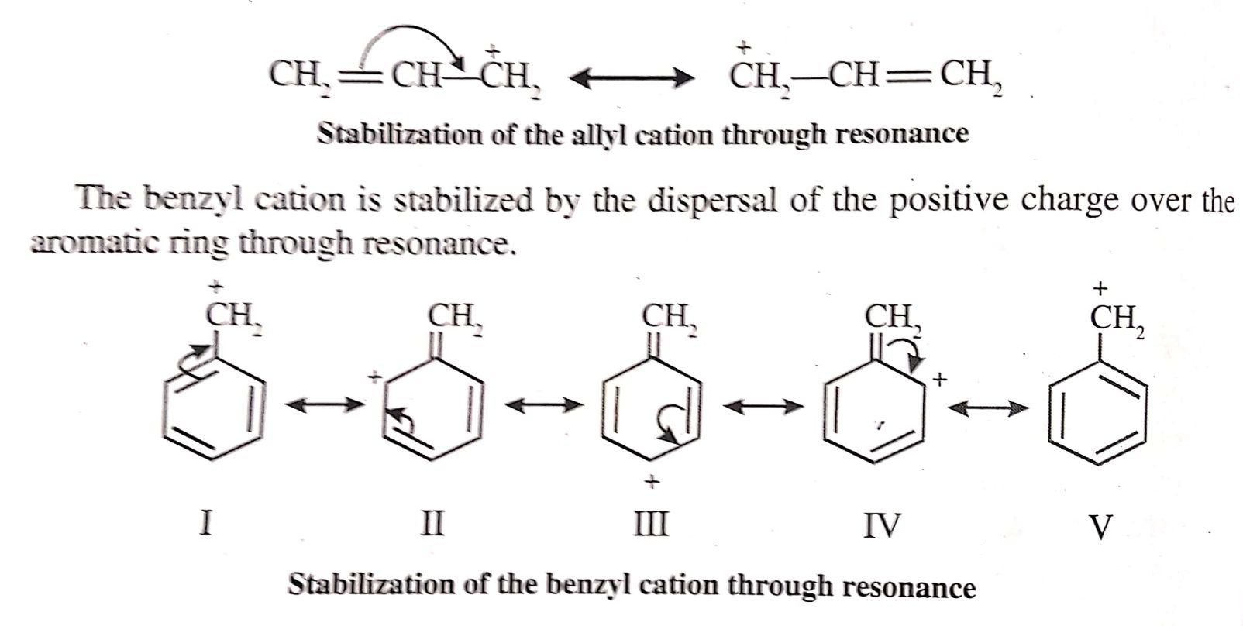
Stability of Unsaturated carbocations based
on resonance

Slide 13
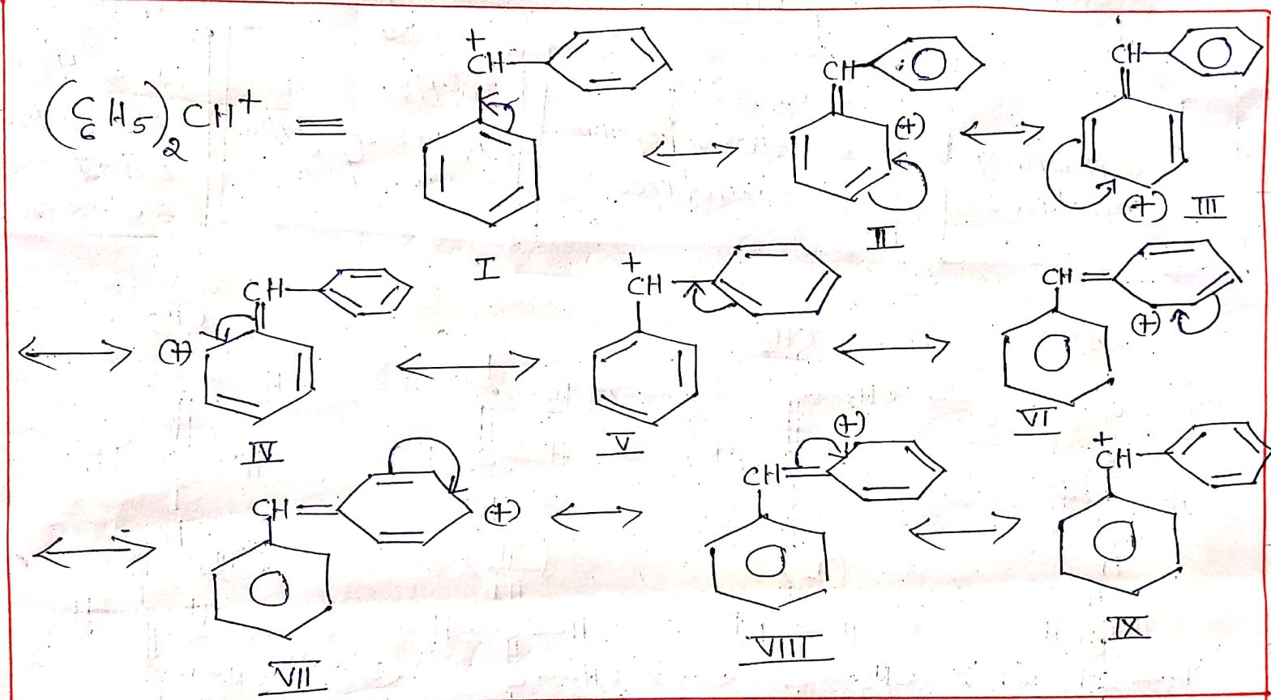

Slide 14
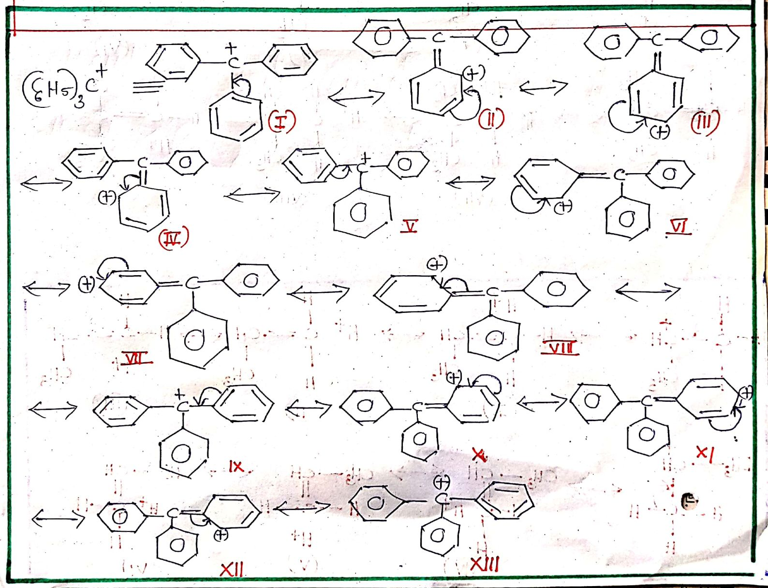

Slide 15
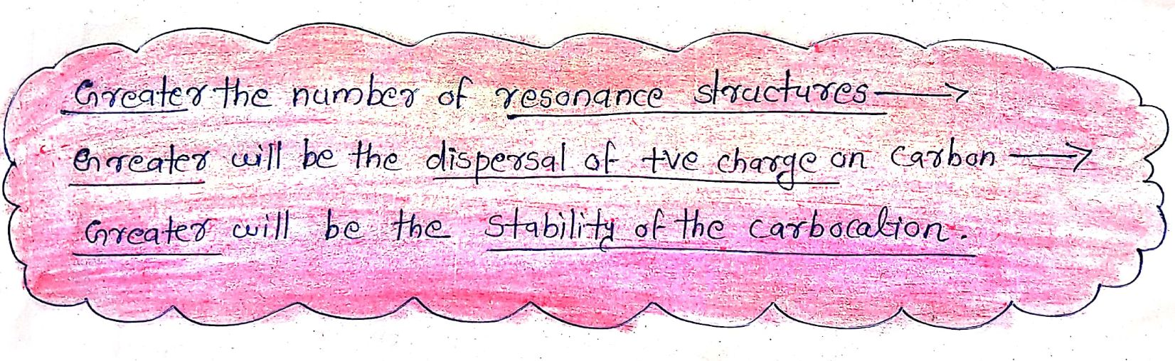
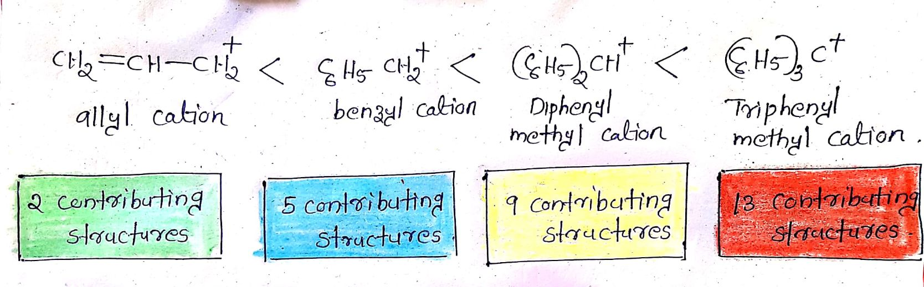

Slide 16
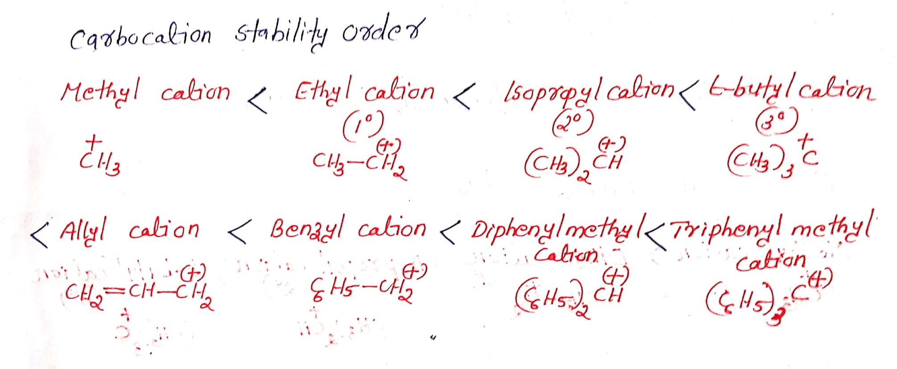

Slide 17
cabanions
A carbocation is a anionic reaction intermediate species that has a carbon that bears a negative charge and has an octet of electrons around it.
In carbocation the negatively charged carbon atom has 8 electrons around it .Thus it is electron rich.Due to the formal charge present on the carbon , carbanions are highly reactive & short lived. Being electron rich with an unshared pair at the negatively charged carbon, carbanions are nucleophiles and lewis bases .They are attacked by electrophiles.

Slide 18
Examples for cabocation are:
⁻CH₃ - Methyl Anion
CH₃-⁻CH₂ -Ethyl Anion
(CH₃)₂⁻CH -Isopropyl Anion
(CH₃)₃ C⁻ -t-Butyl Anion
CH₂=CH-⁻CH₂ -Allyl Anion
C₆H₅-⁻CH₂ -Benzyl Anion

Slide 19
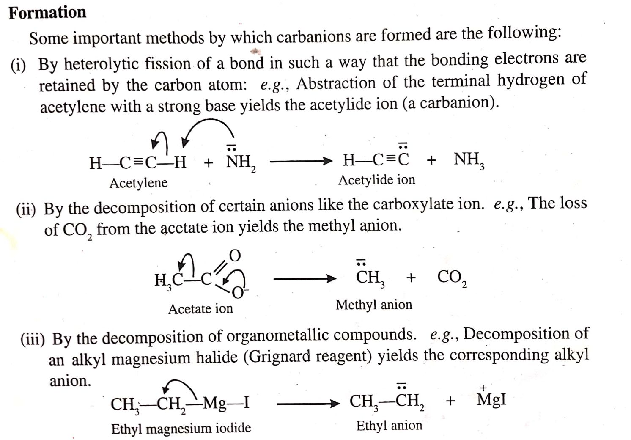
Formation of Carbanion

Slide 20
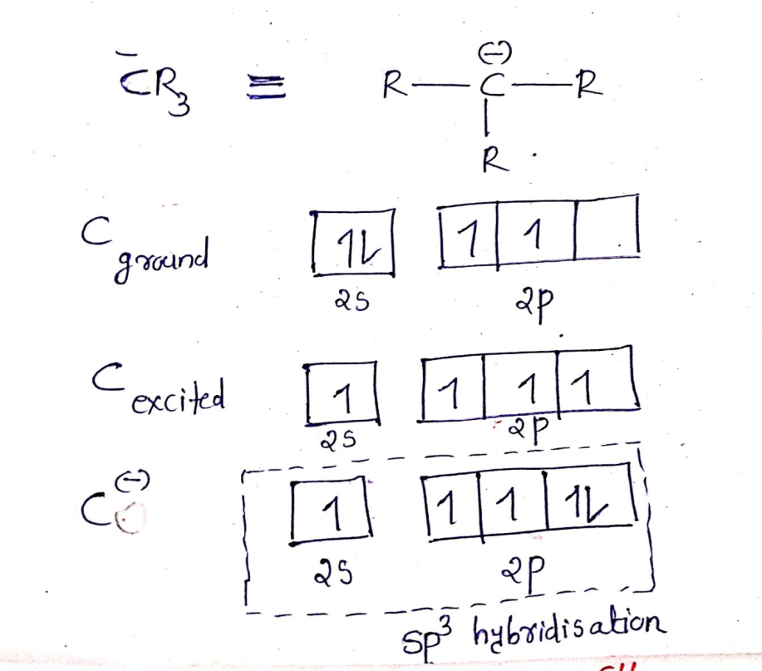
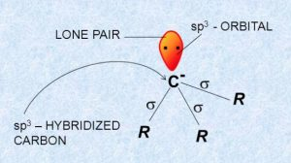
Hybridisation of Carbanion
The - vely charged carbon in carbanion is SP³ hybridised.
The SP³ hybrid orbitals are used to form sigma bonds with three atoms or groups and remaining SP³ hybrid orbital contains the unshared electron pair,creating a trigonal pyramidal structure similar to that of ammonia.Due to lone pair-bond pair repulsions, bond angle in alkyl carbanions are less than 109.5,actually it is between 97 and 100.

Slide 21
Stability of carbanions
Any structural factor that tends to disperse the -ve charge on the carbon and distribute it over the rest of the molecule tends to stabilize the carbanion whereas any factor that tends to intensify the negative charge on the carbon tends to destabilize the carbanion
The presence of Electron – donating group attached to the negatively charged carbon tends to increase the -ve charge on the carbon and thereby tends to destabilize the carbanion.
The presence of Electron –withdrawing group attached to the negatively charged carbon tends to decrease the -ve charge on the carbon and disperse it ,and thereby tends to stabilize the carbocation.
The dispersal of the negative charge on the carbon is possible through resonance or delocalization also.

Slide 22
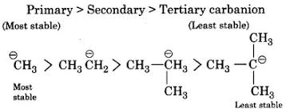
Stability of alkyl carbanions

Slide 23
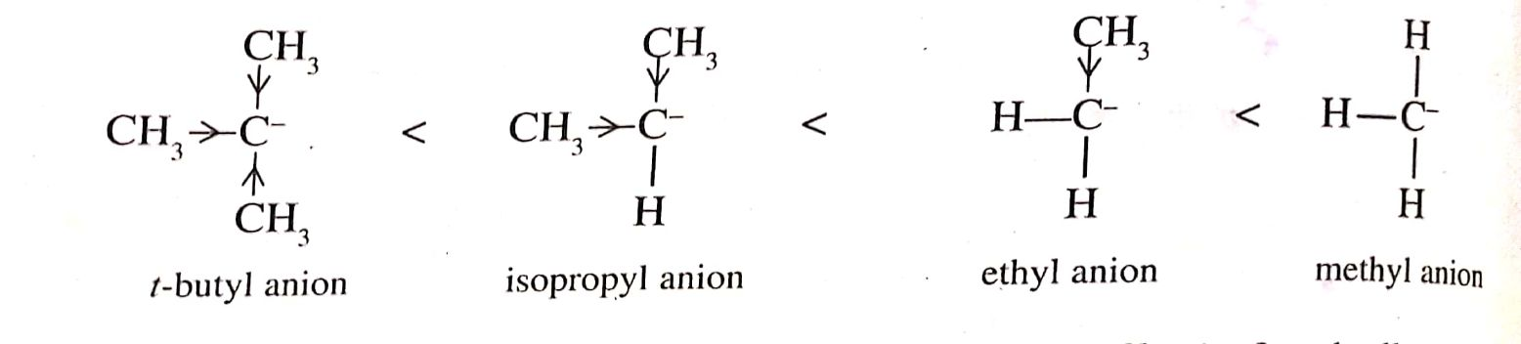
Based on Inductive Effect
CH3 group has electron donating inductive effect. As the no of +I groups connecting to the -vely charged carbon increases ,the - ve charge gets intensified ,which in turn decreases the stability.

Slide 24
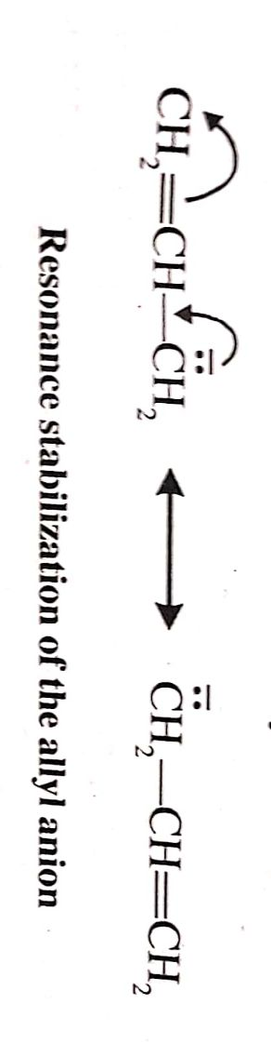
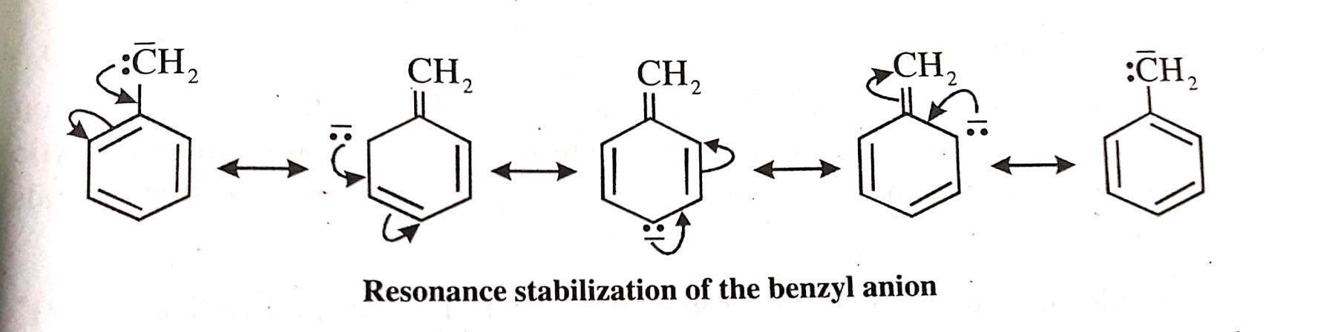
Stability of Unsaturated carbanions based
on resonance

Slide 25
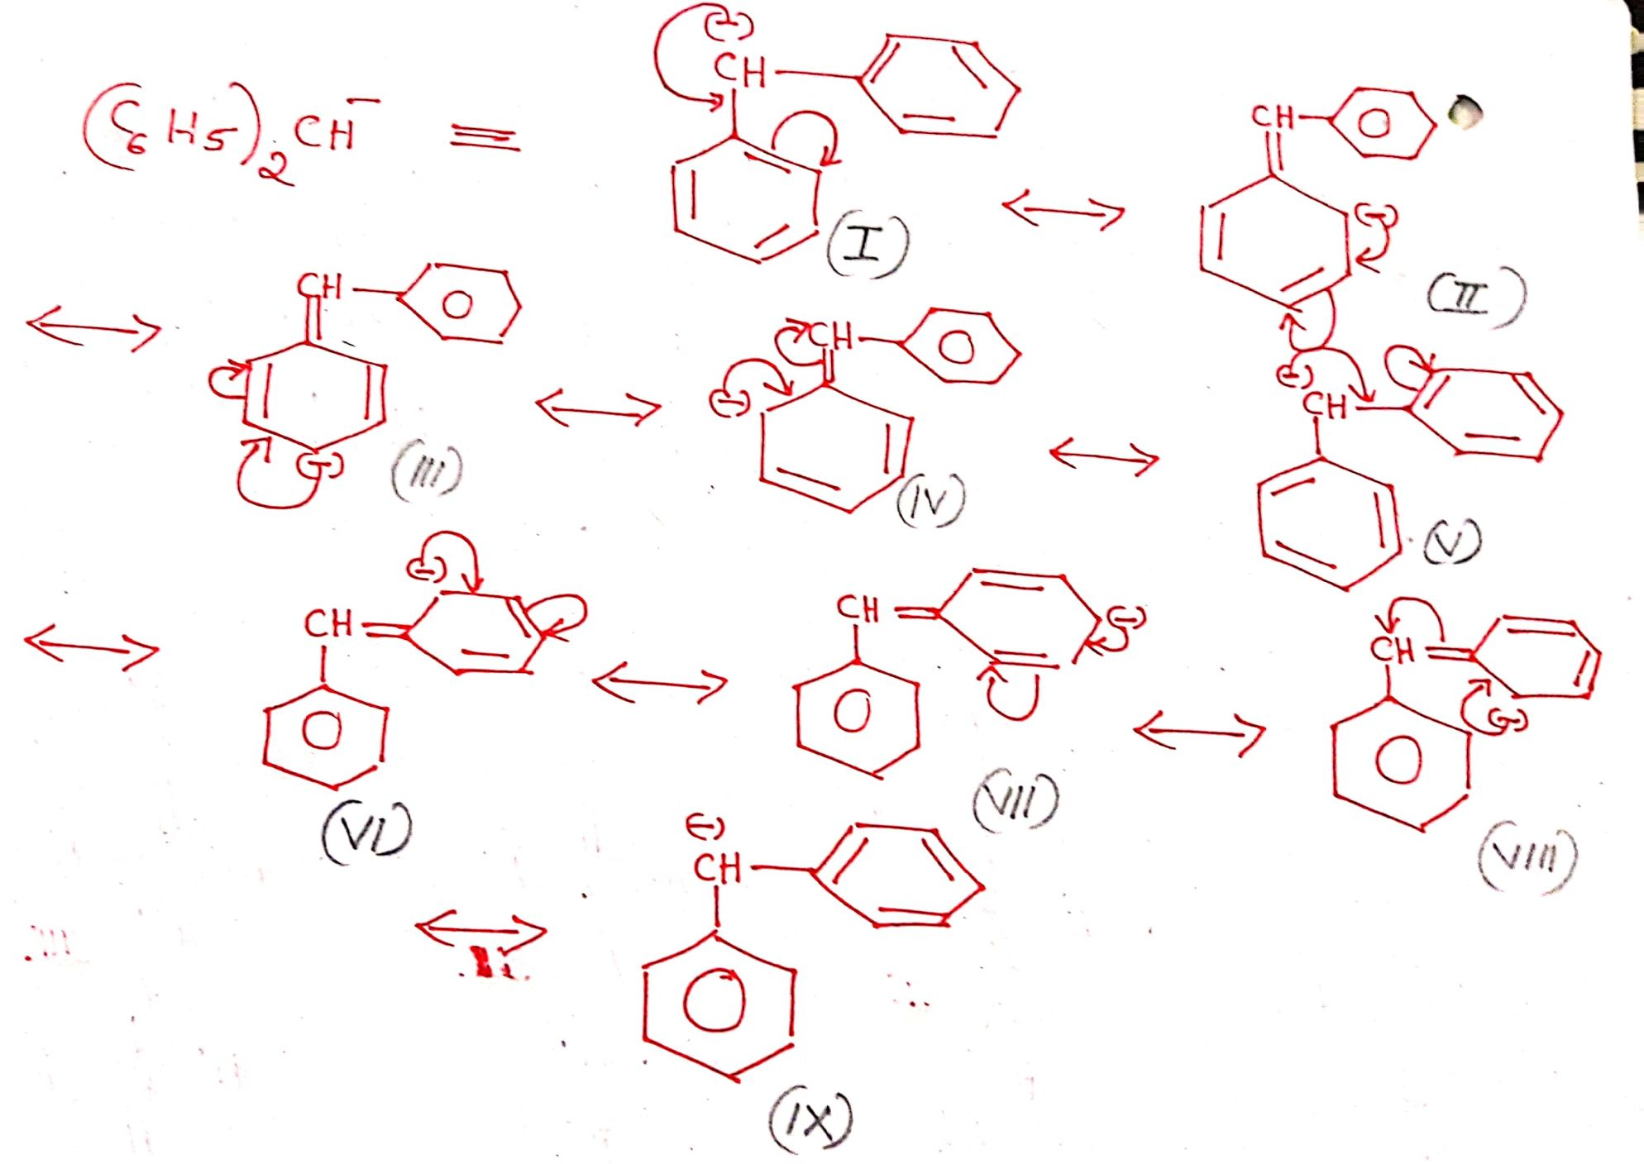

Slide 26
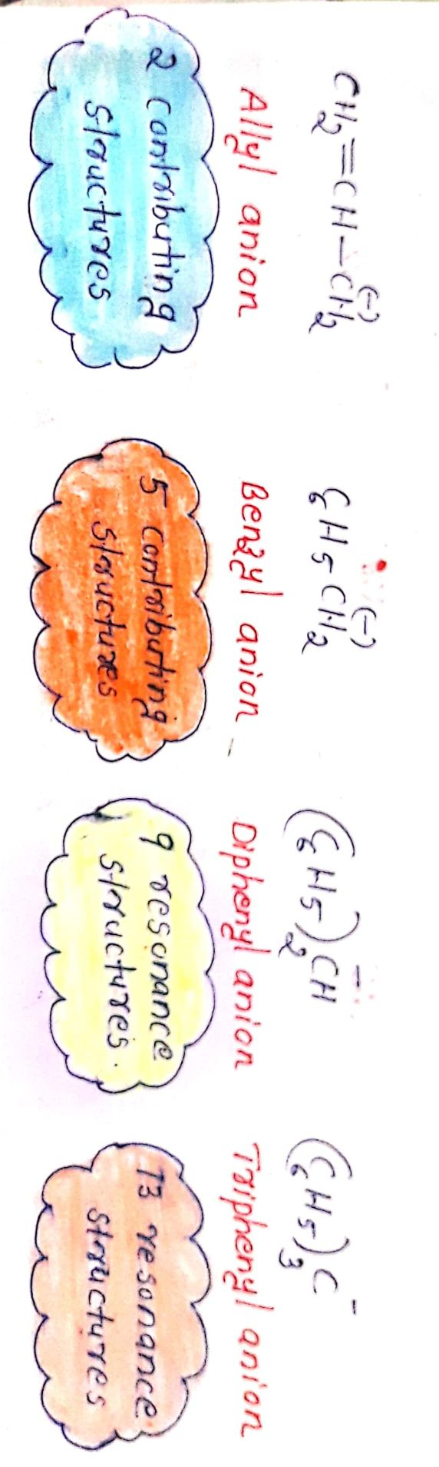

Slide 27
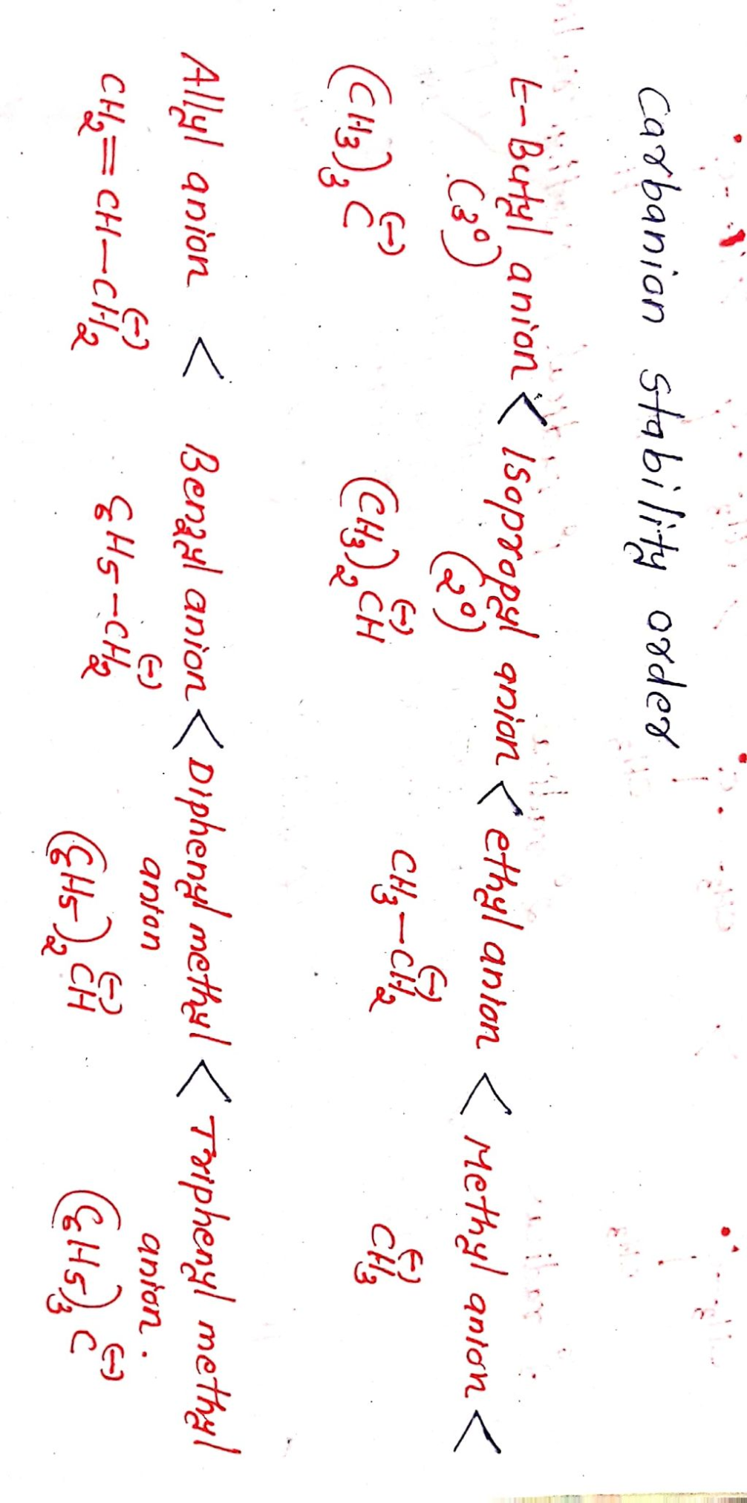

Slide 28
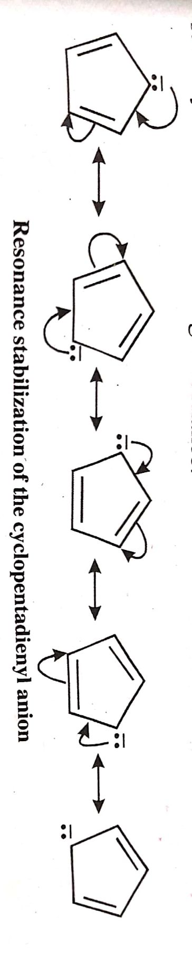
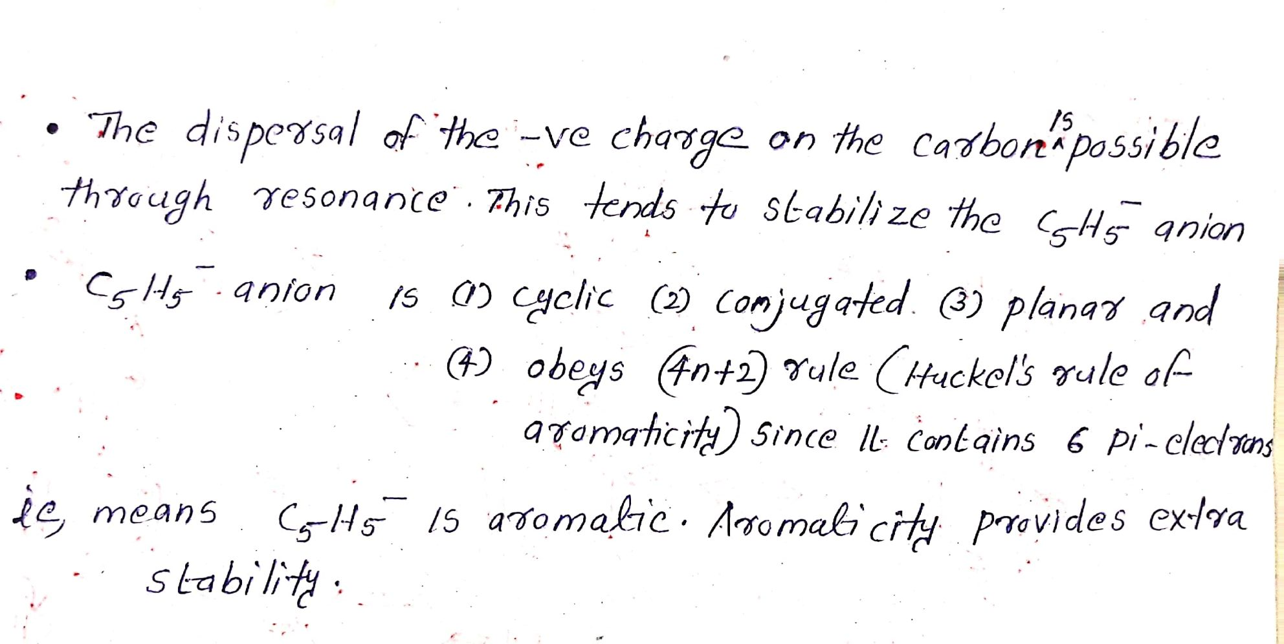
Unsual stability of cyclopentadienyl anion

Slide 29
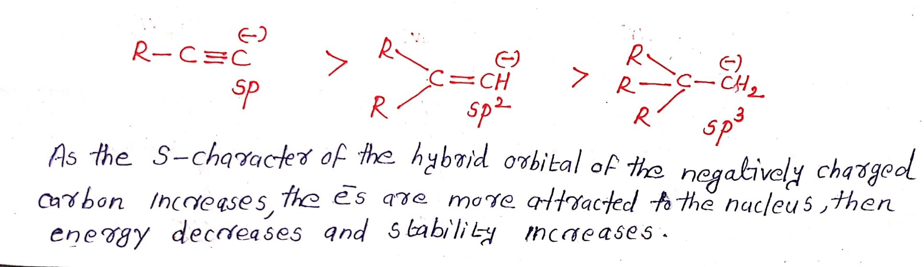

Slide 30
Free radicals
Free radicals are atoms or groups having an unpaired electron.
Free radicals are odd electron species.They are neutral.Because of the tendency of the odd electron present in them to become paired, they are highly reactive and short lived.They are paramagnetic on account of unpaired electron in them.

Slide 31
Examples for cabocation are:
.CH₃ - Methyl radical
CH₃-.CH₂ -Ethyl radical
(CH₃)₂.CH -Isopropyl radical
(CH₃)₃ C. -t-Butyl radical
CH₂=CH-.CH₂ -Allyl radical
C₆H₅-.CH₂ -Benzyl radical

Slide 32
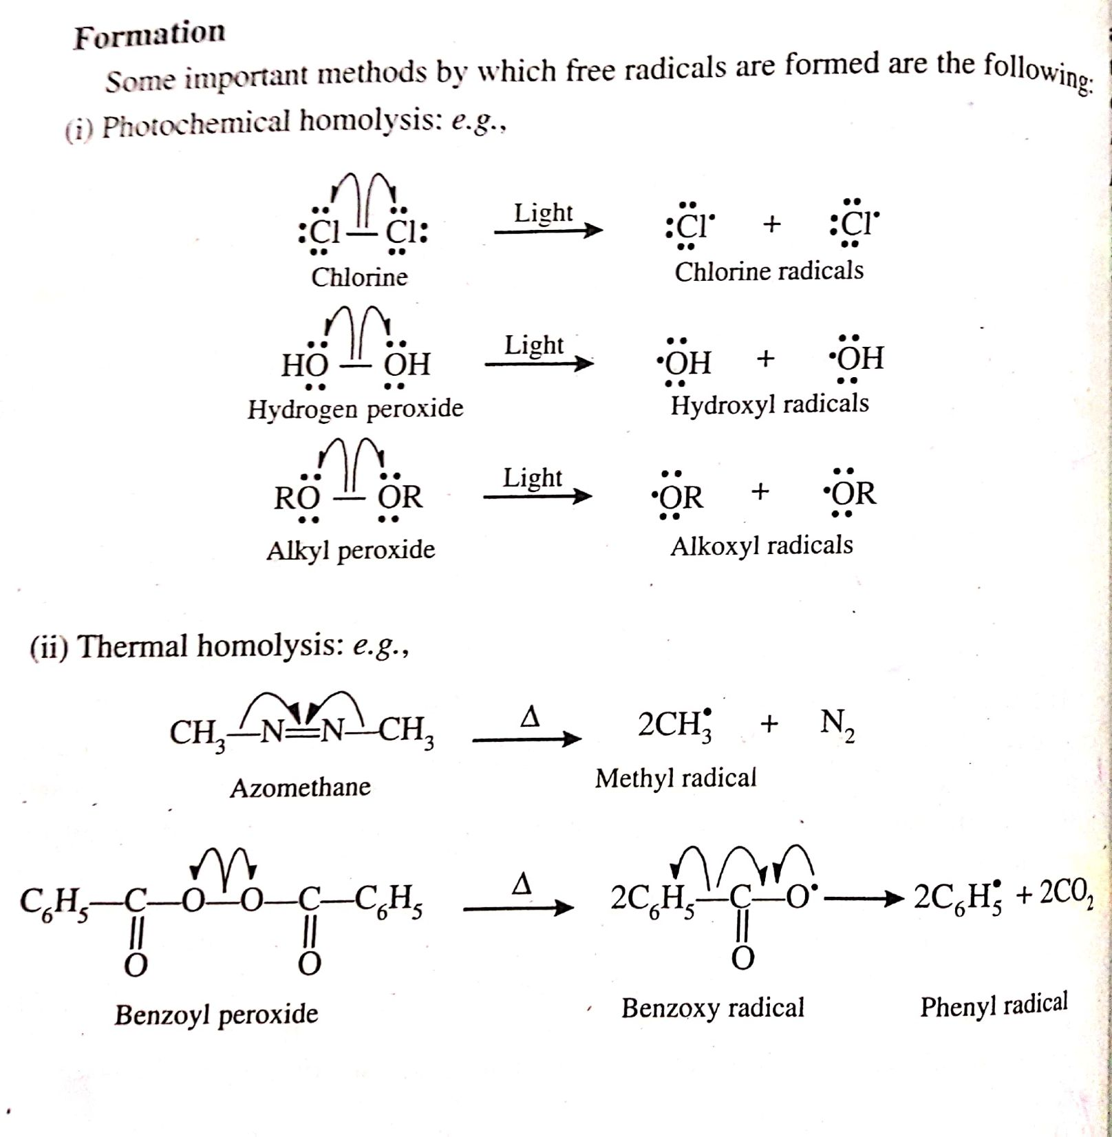
Formation of free radicals

Slide 33
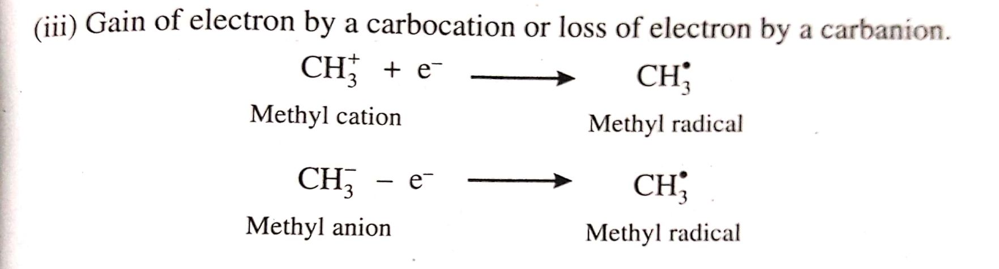

Slide 34
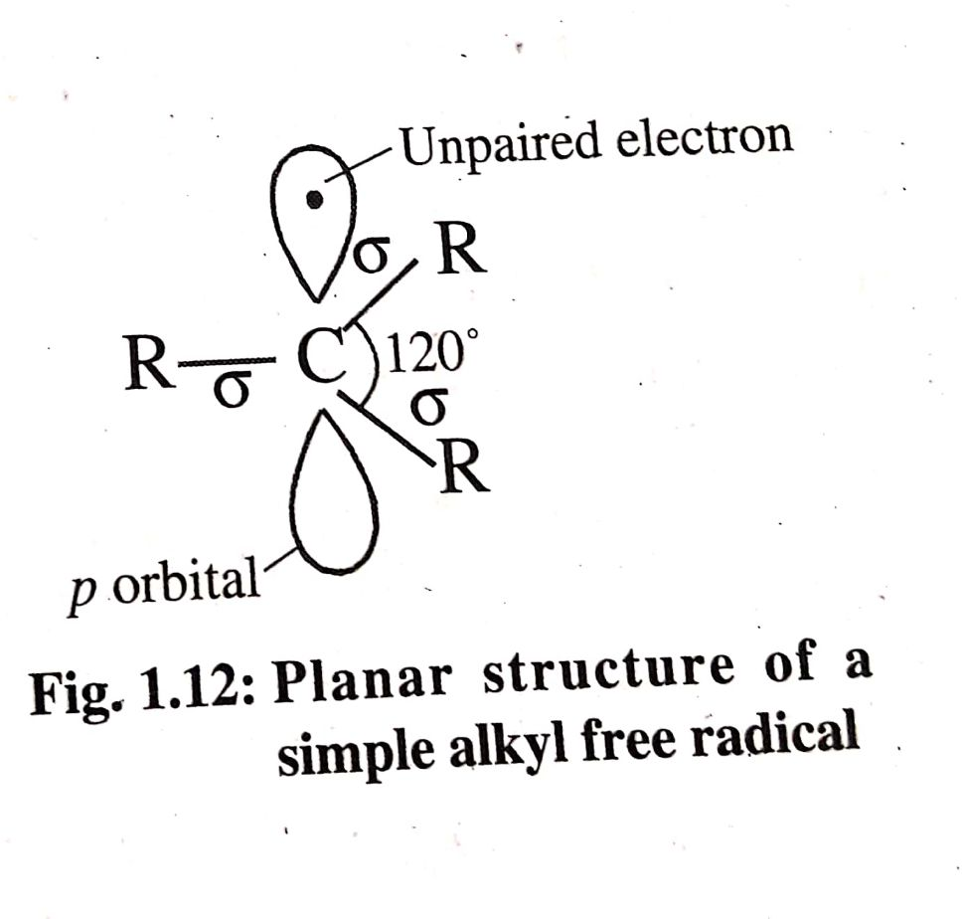
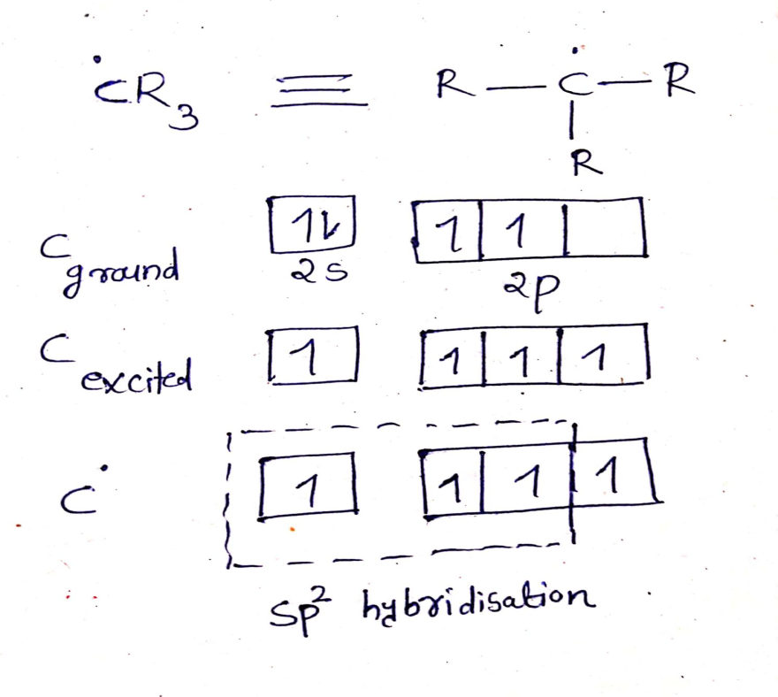
Hybridisation of Free radicals
The carbon bearing the unpaired electron is SP² hybridised.
The SP² hybrid orbitals are used to form sigma bonds with three atoms or groups creating a trigonal planar structure with a bond angle of 120^{0 .}One vacant unhybridised p orbital having an unpaired electron stands perpendicular to the above plane.

Slide 35
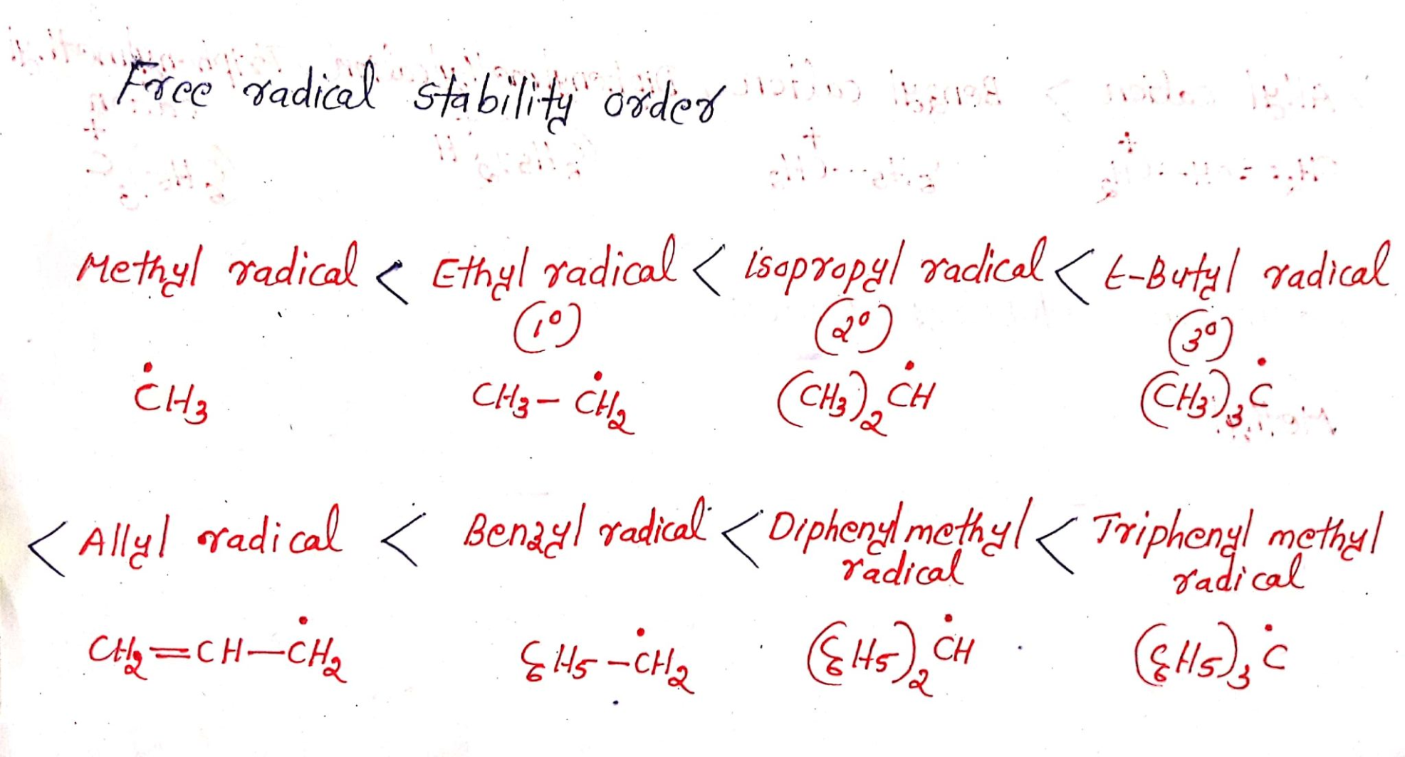
Stability of alkyl free radicals

Slide 36
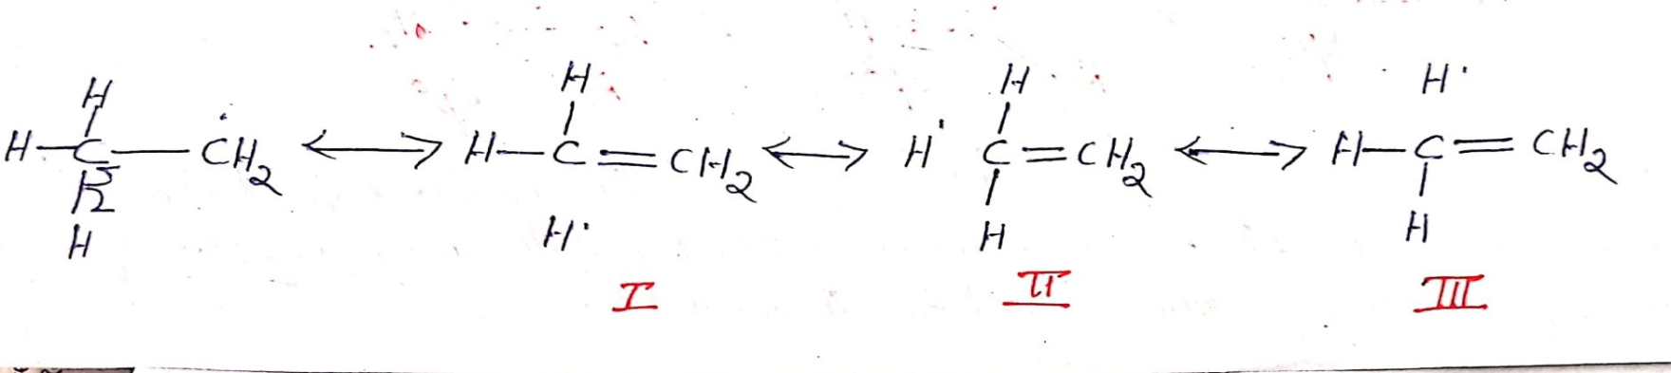
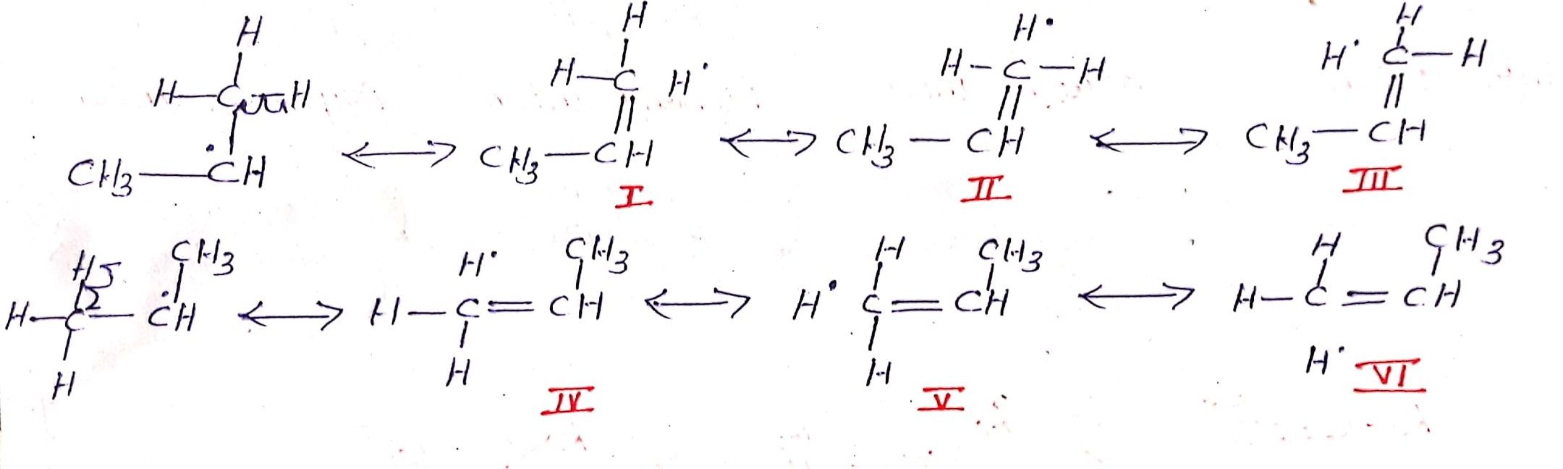
Based on Hyperconjugative Effect
Methyl free radical(Primary free radical)
Isopropyl free radical (Secondary free radical)

Slide 37
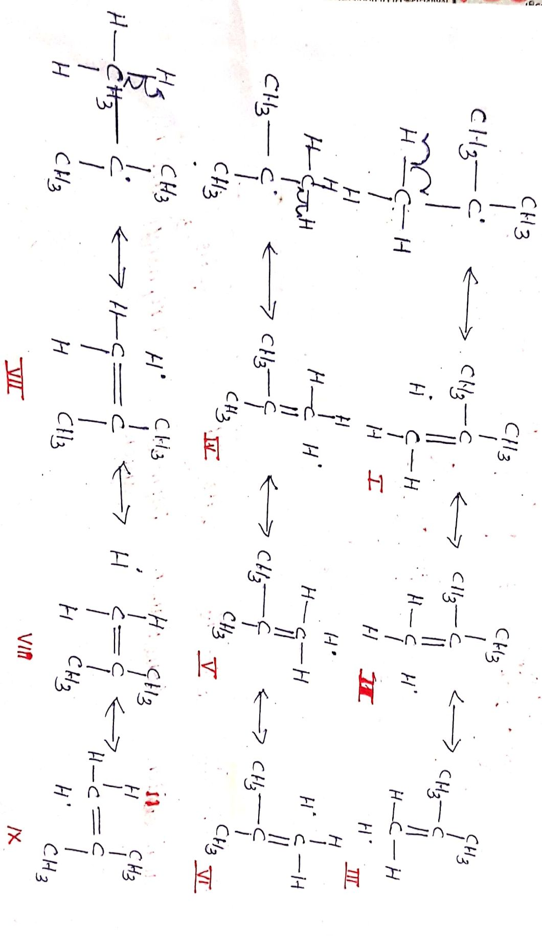
t-Butyl free radical (Tertiary free radical)

Slide 38
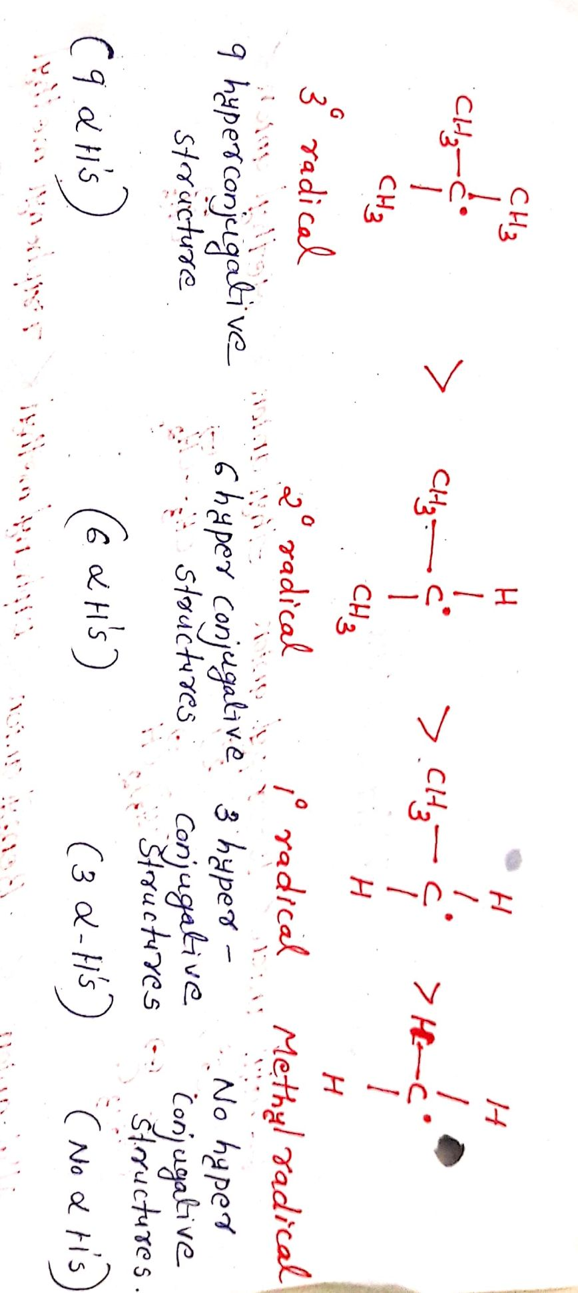

Slide 39
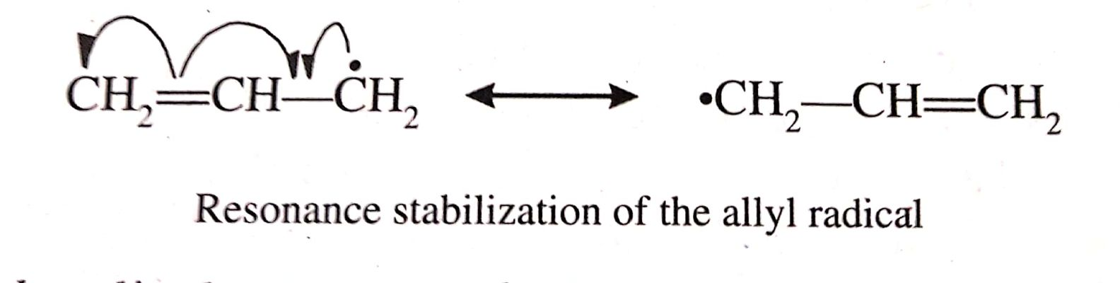
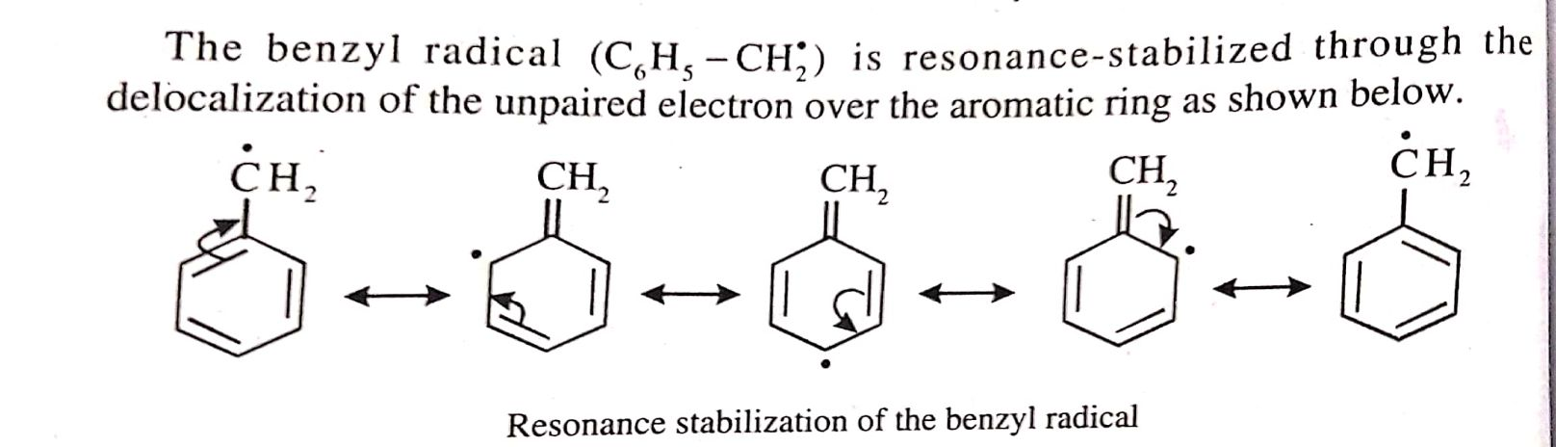
Stability of Unsaturated carbanions based
on resonance

